Slide 1
Website for a Dance Studio
Samantha Smith

Slide 2

Naming the Files
First, I started by naming all the files, starting with index.html
and naming the others accordingly.

Slide 3
Page Titles
Then, I gave every file an appropriate title name.
Ex.

Slide 4
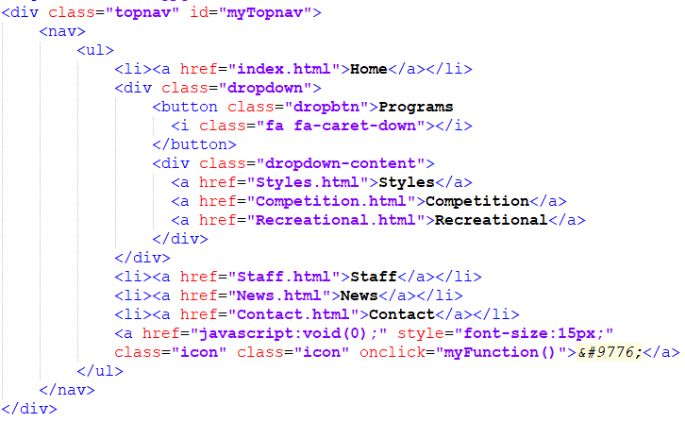
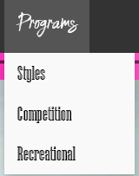
Navigation
Then, I added my navigation.

Slide 5

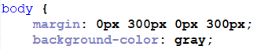
Setting background color
Then, I set the background color for the body

Slide 6
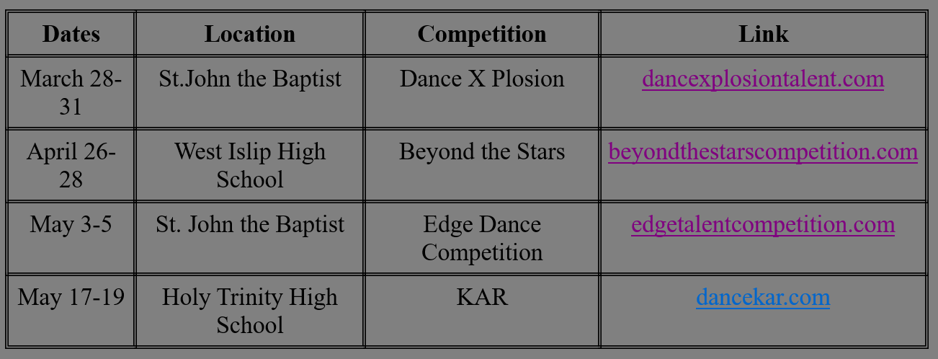
Adding a Table
Within my news file, I added a simple table
I also included other links to other websites in this table.

Slide 7

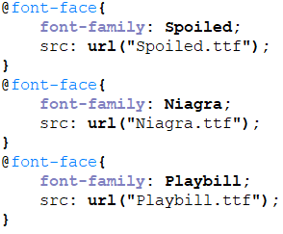


Adding Fonts
Then I added 3 fonts to the stylesheet

Slide 8
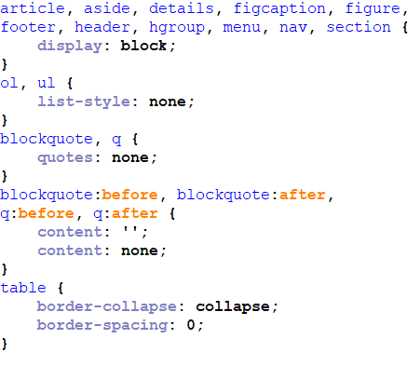
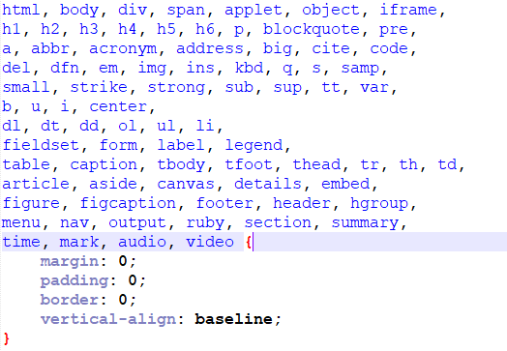
Reset Style Sheet
I then added a reset style sheet.

Slide 9
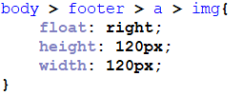

Creating a Floating Element
This was one of the floating elements I added.

Slide 10
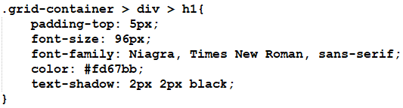
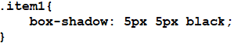

Text-Shadow and Box-Shadow
I put a text-shadow and a box-shadow on an element.

Slide 11
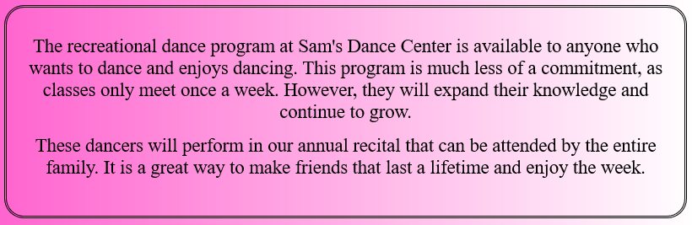
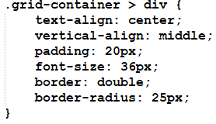
Borders Around Text
I put borders around text elements throughout, as well as rounded corner’s on the borders.

Slide 12
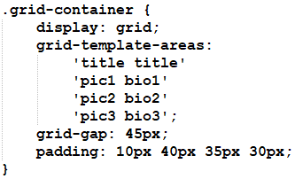
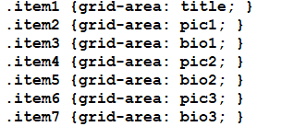
Using Grids
I used grids on all of the pages to aid in attaining an appealing website.

Slide 13
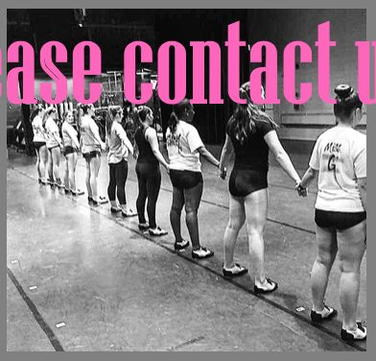
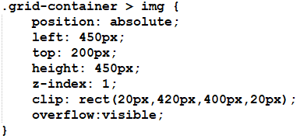
Clip Property
The clip property was only used once.
I used the property to clip this image a little bit smaller.

Slide 14
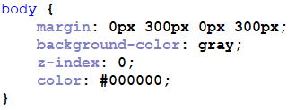
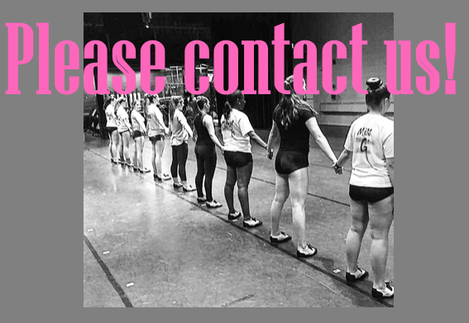
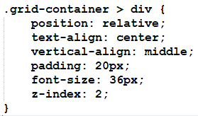
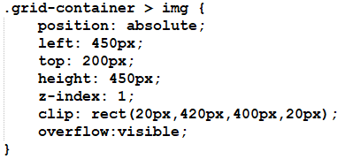
Stacking Elements
I used the clipped picture to stack with a sentence, as well as for the background-color.

Slide 15
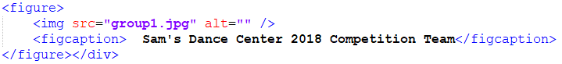
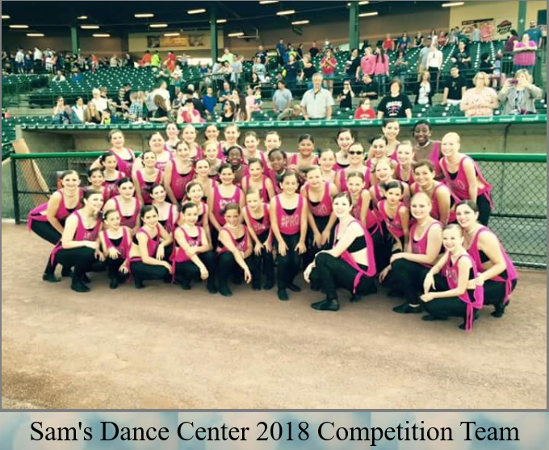
Figure Box and Caption
I used the figure box and figcaption property for the home page.

Slide 16
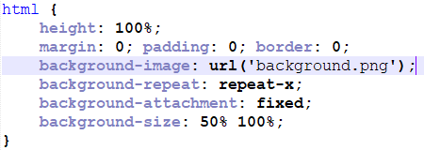
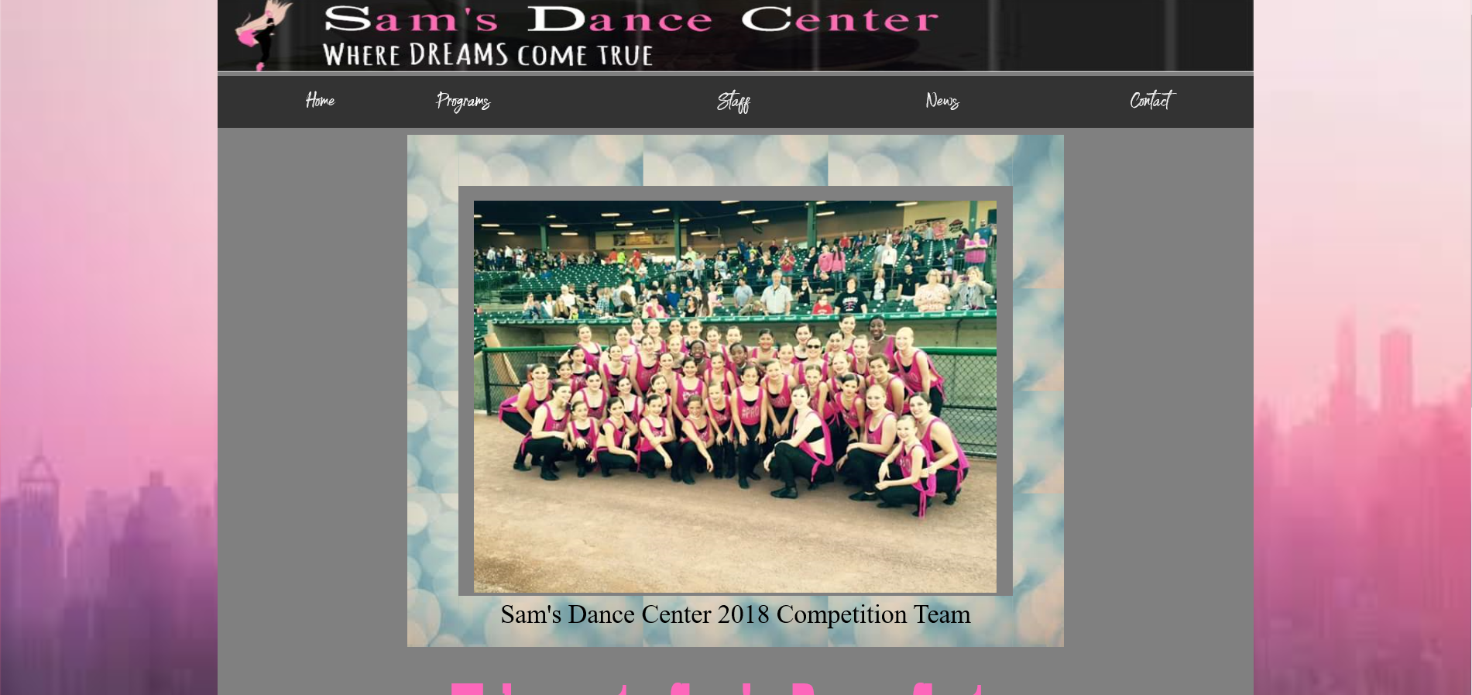
Background Tiling
I used the background tiling to tile the html background.
Actually tiled and repeated behind the body background.

Slide 17
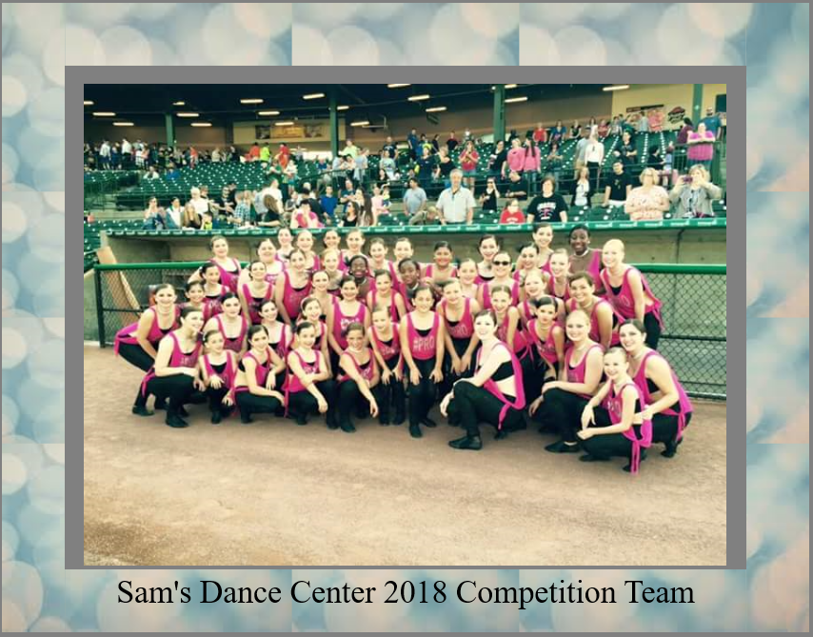
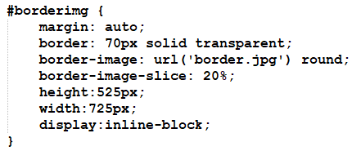
Border Image Slice
I used the property to add a nice border around the home page’s picture.

Slide 18

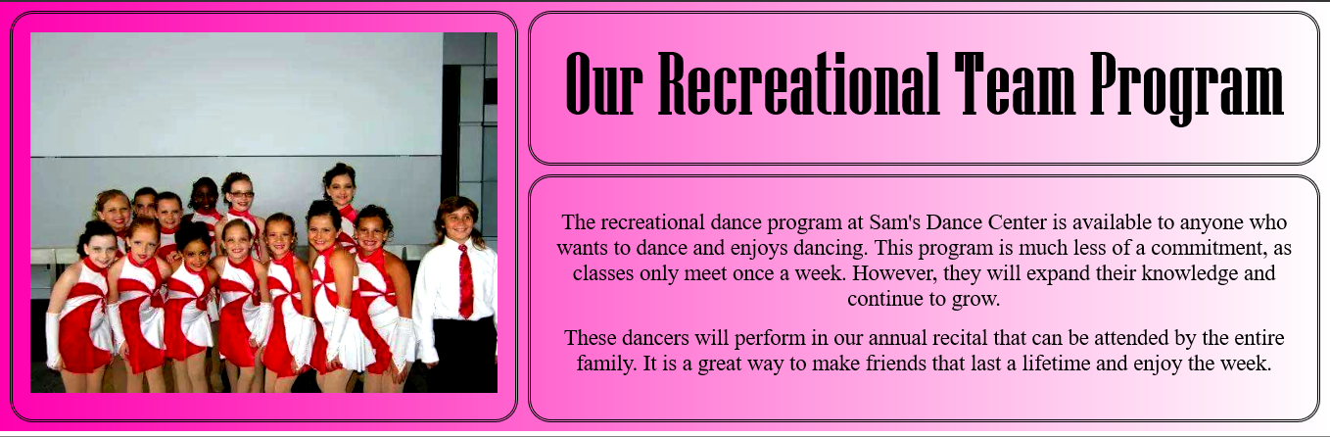
Gradients
I applied the gradients to two grid containers.

Slide 19


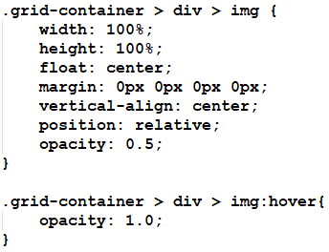
Semi-Transparent
I put the transparency over the staff photos until you hover over them.

Slide 20
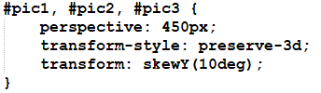
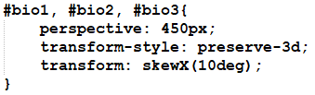
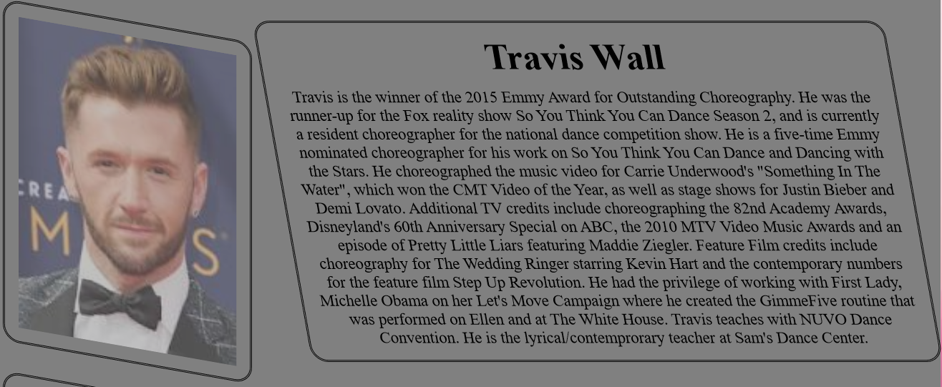
Object Transformations & 3D
I used 2 transformations on the staff page.

Slide 21

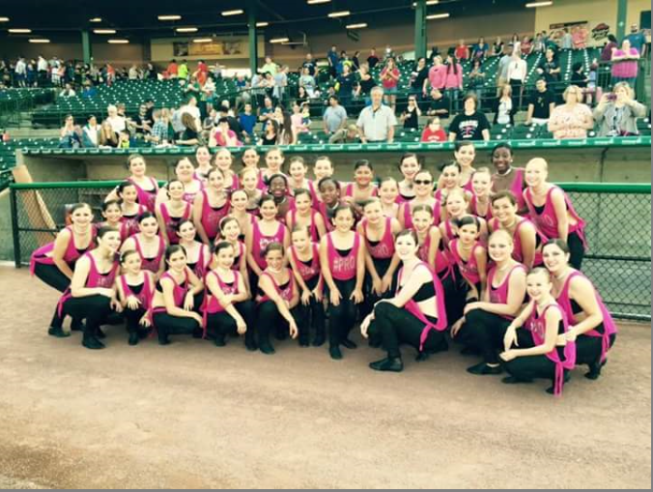
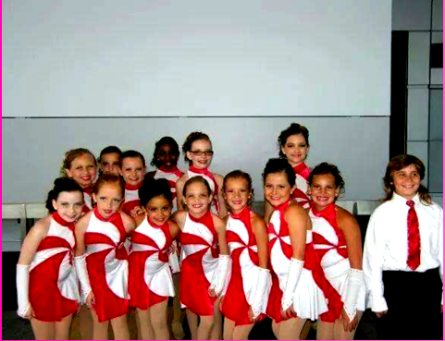
Filters
I used 3 filters on different pictures.

